Slide 1
IoT implementation using FPGA-Microcontroller communication
By Andrew Zakhary
Under supervision of Prof. Dr.-Ing. Ali Hayek

Slide 2
Table of contents
01
02
03
04
Motivation
Methodology
Importance of FPGAS, IoT and the goals of the project
How the work is structured
Implementation
Discussion
The body of the work
Importance of the results and future outlook

Slide 3
01
Motivation
Importance of FPGAS, IoT and the goals of the project
Notes:
So first, I will introduce some key concepts and discuss the motivation of the project.

Slide 4
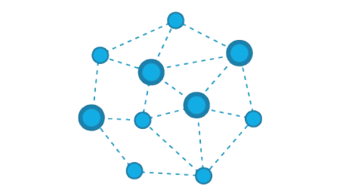
IoT
11.5 Billion devices in 2022.
Low-powered wireless devices
Non hierarchical structure
Multiple protocols
Notes:
In 2022 the number of connected devices to the internet exceeded the number of people on the planet. This ushered in whats called IoT. This was enabled by the fact that devices which are able to connect to communicate through the internet became cheaper and smaller. As a result the old hierarchical structure of network became very inefficient which led to new structures where all nodes can communicate together. This required different protocols with varying degrees of speed, range and security.

Slide 5
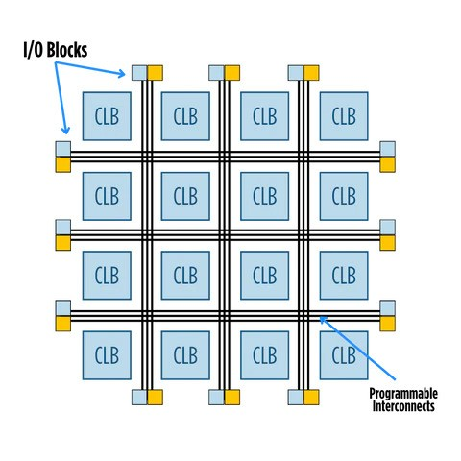
FPGAS
Matrix of CLBs
Reprogrammable
Useful for prototyping
Notes:
so here in figure 1 we can see the structure of an FPGA. This is a matrix of configurable logic blocks which are logic gates with programmable wires between them. What makes FPGAs unique is that these wires can be endlessly reprogrammed to allow them to perform any computational task. This makes them very useful in prototyping and also in production in low to medium scales

Slide 6
Motivation
FPGA-Microcontroller IoT network
Multiple protocols implemented
Simulate industrial environment
Notes:
For this project however, I wanted to try to implement an IoT network where the nodes are a uC and an FPGA. This requires different protocols with wired and wireless connections as well. At the end this should show that in an industrial setting where architectures are different, IoT can still enable cross communications.

Slide 7
02
Methodology
How the work is structured
Notes:
Now I will be discussing our proposal and the structure of the work

Slide 8
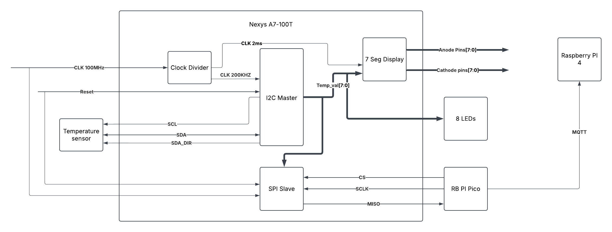
Block diagram
Notes:
Here is a block diagram of the project plan. We see the FPGA processing the reading from the temperature sensor through an I2C connection which is then shown on the 7 segment display and the LEDs as well. This value is then transferred to a raspberry pi pico w which is a uC over SPI connection which in turn transfers that wirelessly though mqtt to the raspberry which is both a node and the broker.

Slide 9
03
Implementation
Outcome of the work
Notes:
Now we can see some details of the implementation

Slide 10
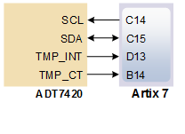
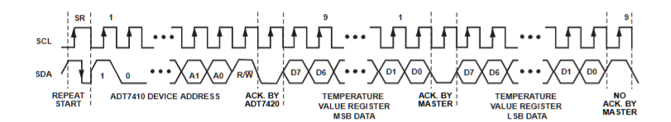
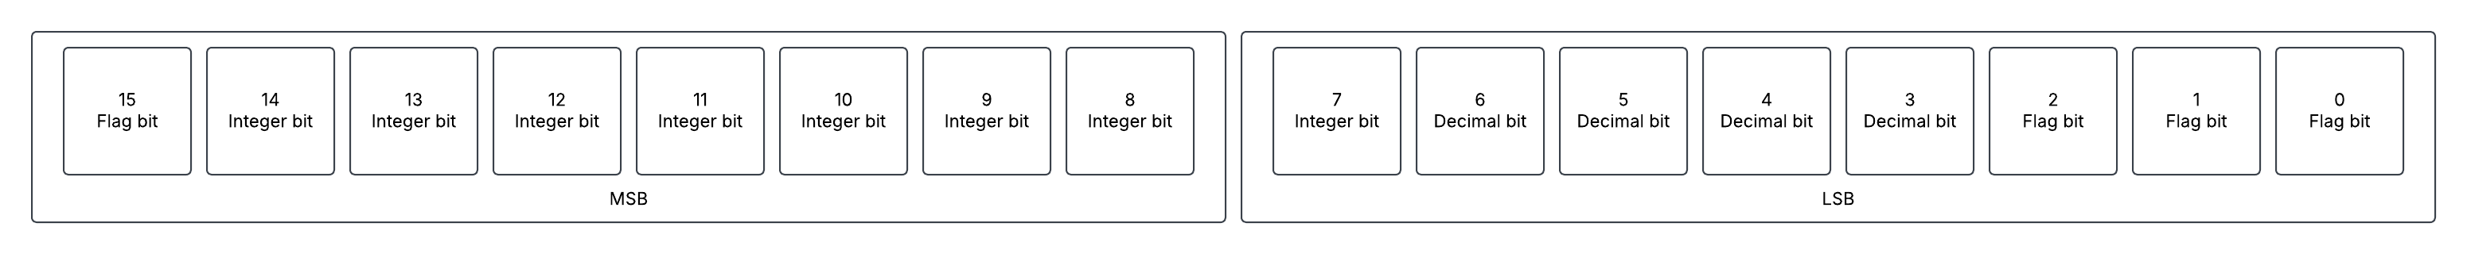
I2C master
Required lines
Required sequence
Reading the result
Notes:
The i2C protocol used to communicate between the FPGA and the ADT7420 temperature sensor. For this interface, 2 lines are necessary. These are the SCL carrying the clock data and the SDA line carrying the data bits. For this device the communication starts by a high bit on a high clock signal. Then the master needs to start sending the device address which is followed by a read bit “1”. The device then receives the ACK from the sensor and then receives the tMSb and LSB. Here we can see the MSB and the LSB split into their bits. As we want to measure integers in degrees we can focus only on bits 14:7

Slide 11
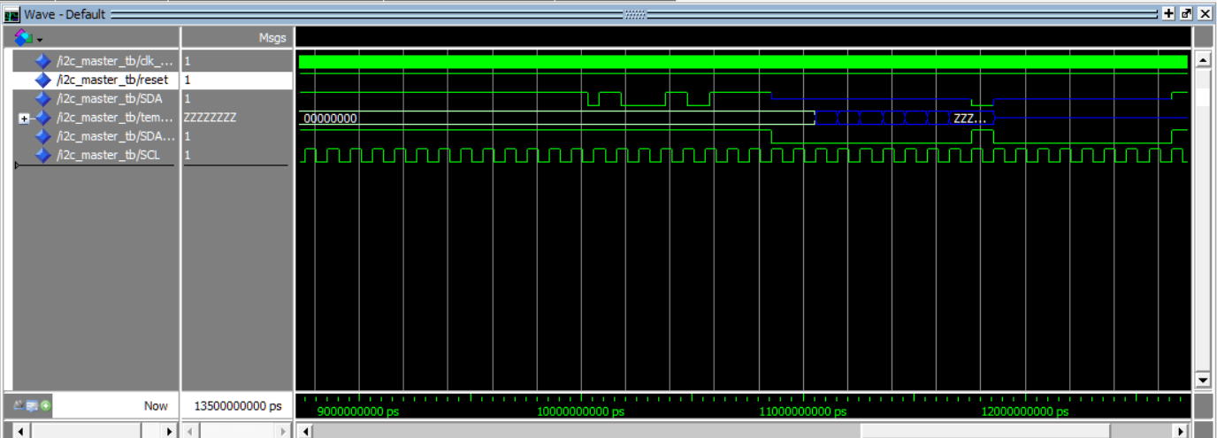
I2C master
Notes:
Here we can see the waveform simulation of the VHDL component

Slide 12
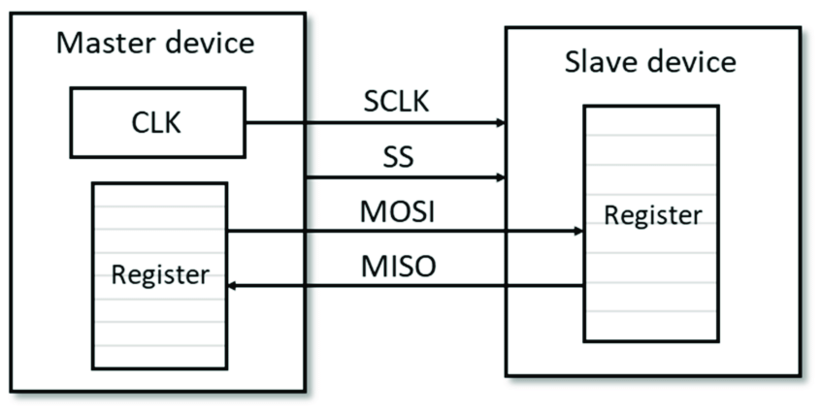
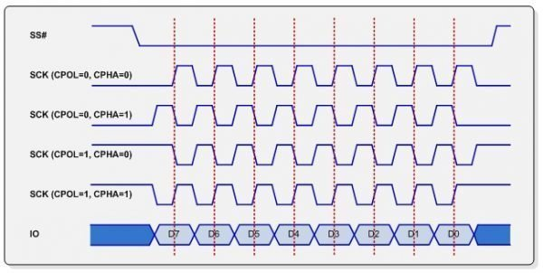
SPI slave
Required lines
SPI modes
Using sync clocks
Notes:
The SPI protocol is used to communicate between the FPGA and the Pico W uC. This protocol requires 4 lines, clock, ss , mosi and miso. The master (pico w ) in this case is the master so it is responsible for generating the clock and the SS signal. In this case we are using phase 0 and pol 0 so the clock is 0 at idle and the data is sampled on the raising edge of the clock.

Slide 13
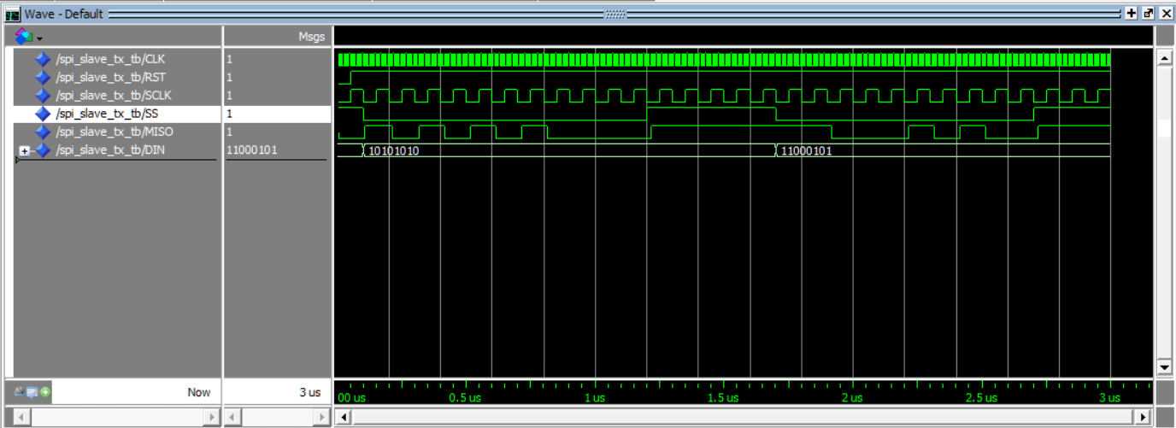
SPI slave
Notes:
Here we can see the waveform simulation of the VHDL component

Slide 14
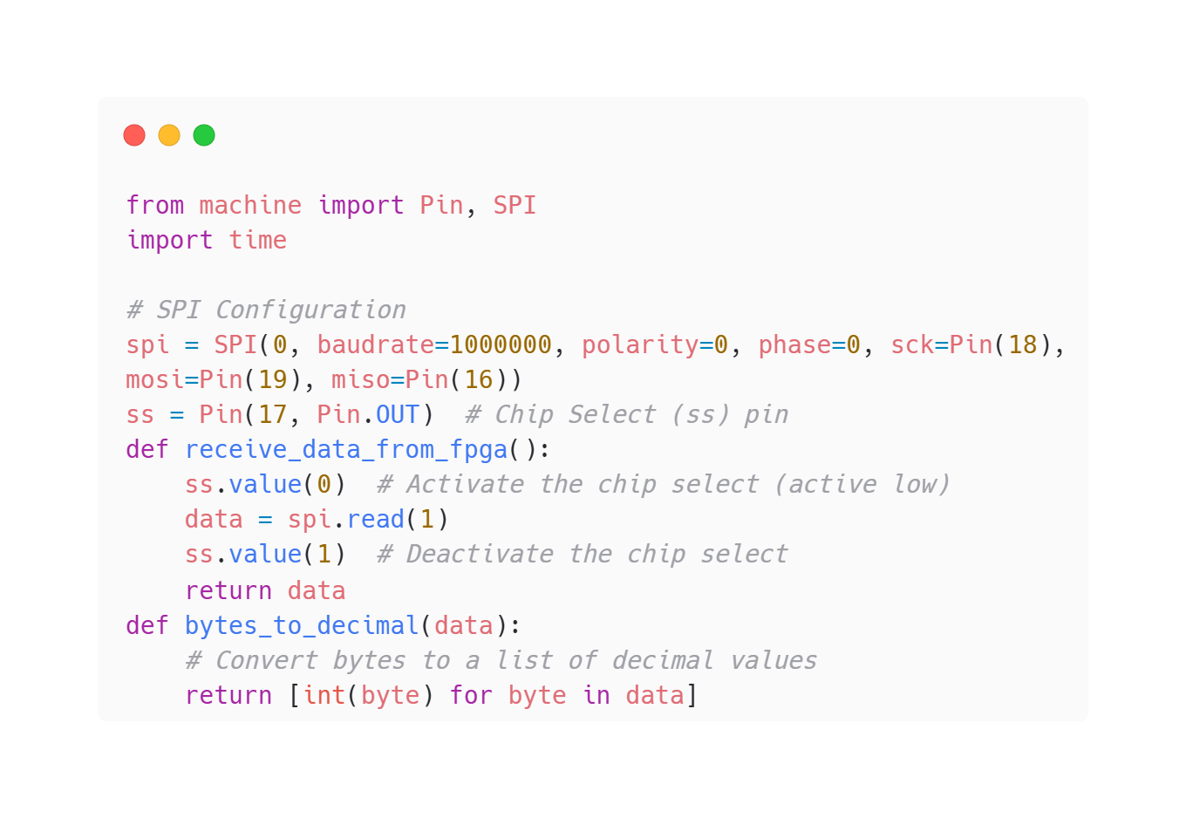
SPI Master
Required lines
SPI modes
Using sync clocks
Notes:
Here the SPI Master is defined with specifying the baudrate which is the speed of the clock, polarity, phase and the pins as well. Then functions for receiving the bit stream sets the SS line low, reads one byte and then setting SS line high again. Another function is added to convert the byte into a decimal value

Slide 15
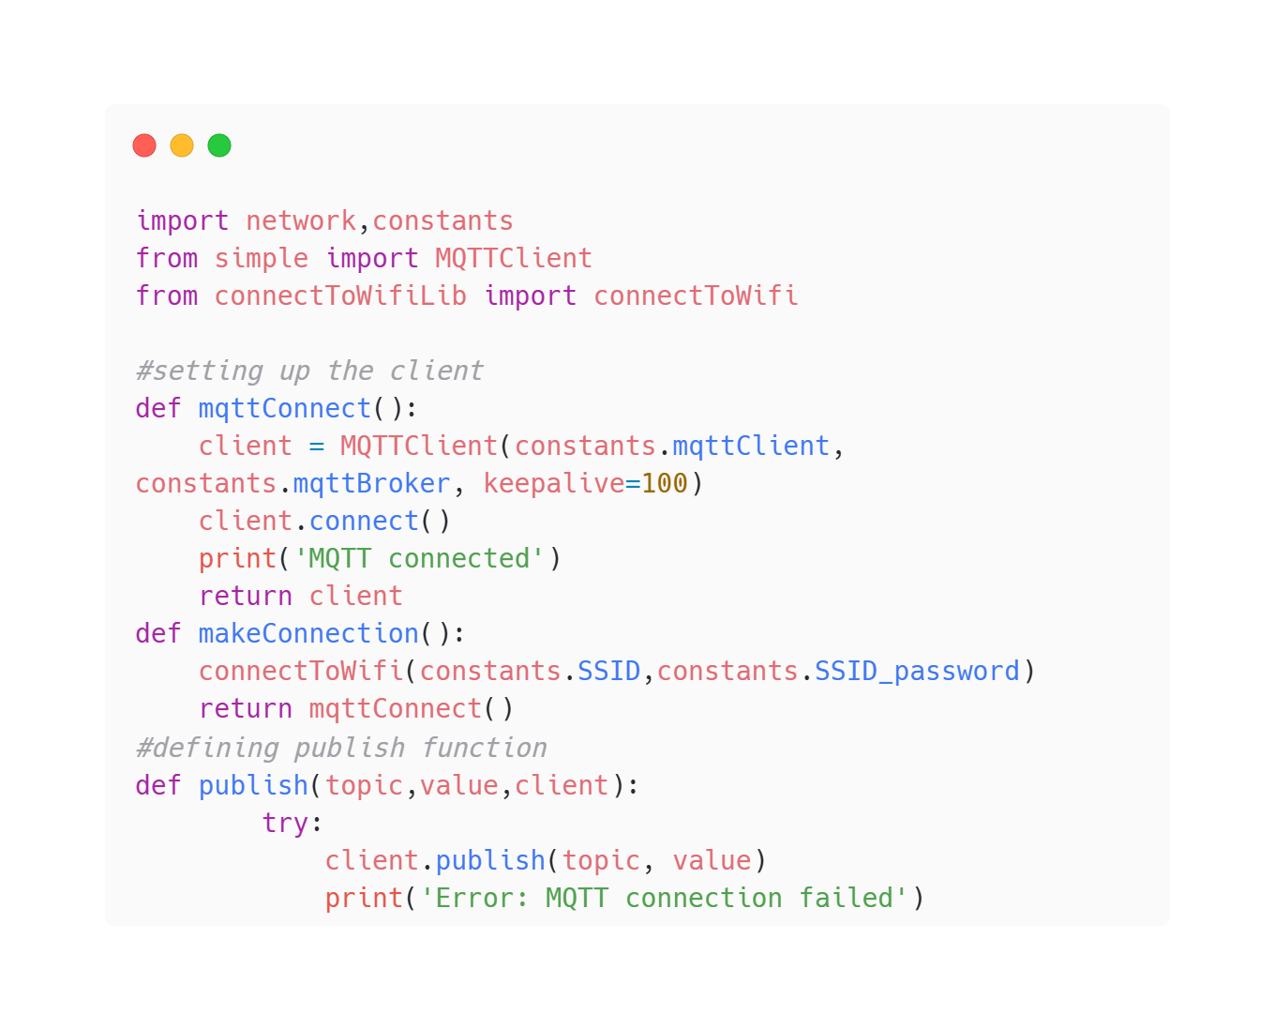
MQTT node
Connect to the internet
Connect to the broker
Publish information
Notes:
MQTT is a wireless communication protocol which is used to communicate between the Pico and the raspberry pi 4. here the pico is set as a publisher which will send the information to the broker under a specific topic. The pico is first connected to the internet, and then it connects to the broker via its IP. At the end it can publish the reading values

Slide 16
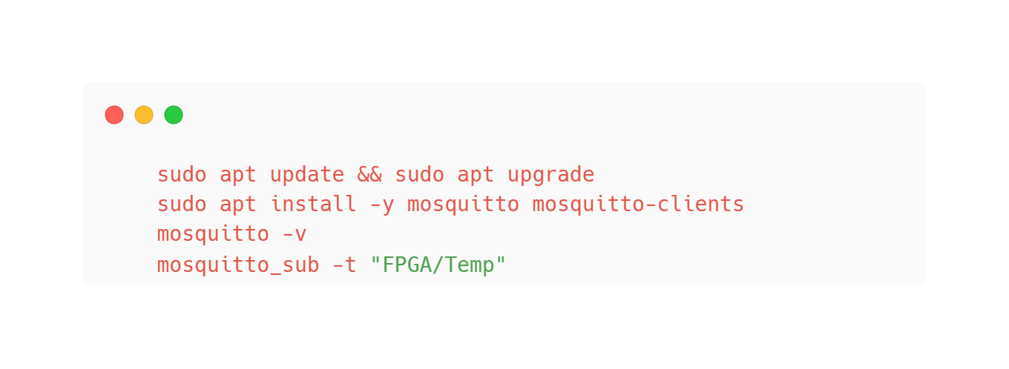
MQTT node
Install mosquitto client
Run the client
Subscribe to topic
Notes:
On the pi board its much simpler, all we need to do is install the mosquito package, run the package and subscribe to the same topic that the pico is publishing to

Slide 17
04
Discussion
Importance of the results and future outlook

Slide 18
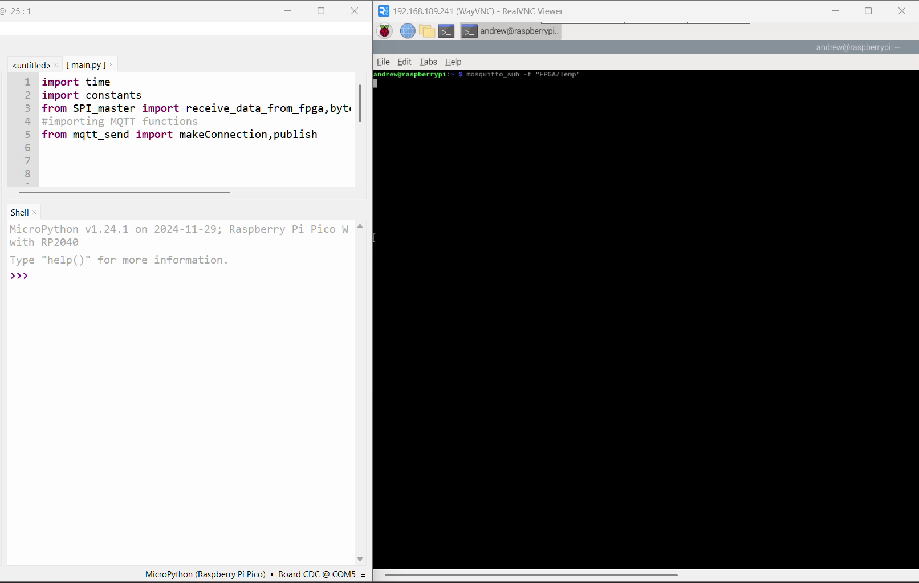
Discussion
Why Microblaze-V approach failed
Devices are communicating without problems
FPGA-uC in IoT can be practical
Notes:
The project started as an attempt to only use the FPGA board without the uC by building a linux image on the FPGA and using this build the wireless IoT communication but this failed due to time constraints. This approach however still worked without problems and we see here the pico and the pi passing around the information. This shows how in an environment with different architectures, communication protocols specially, iot can still be used to communicate devices together.

Slide 19
Future plans
Online dashboard
Additional nodes including actuators
PCB design for the FPGA-uC

Slide 20
Thank you for your attention

